Slide 1
Unit-4

Slide 2
Computational Learning Theory
Computational learning theory, or CoLT for short, is a field of study concerned with the use of formal mathematical methods applied to learning systems.
Computational learning theory may be thought of as an extension or sibling of statistical learning theory, or SLT for short, that uses formal methods to quantify learning algorithms.
Computational Learning Theory (CoLT): Formal study of learning tasks.
Statistical Learning Theory (SLT): Formal study of learning algorithms.

Slide 3
Computational learning theory is essentially a sub-field of artificial intelligence (AI) that focuses on studying the design and analysis of machine learning algorithms.
How important is computational learning theory?
Computational learning theory provides a formal framework in which it is possible to precisely formulate and address questions regarding the performance of different learning algorithms. Thus, careful comparisons of both the predictive power and the computational efficiency of competing learning algorithms can be made. Three key aspects that must be formalized are:
The way in which the learner interacts with its environment,
The definition of success in completing the learning task,
A formal definition of efficiency of both data usage (sample complexity) and processing time (time complexity).

Slide 4
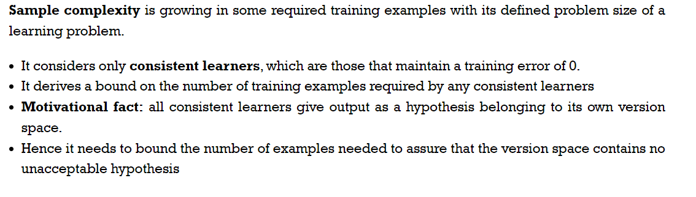
Sample Complexity for Finite Hypothesis spaces

Slide 5
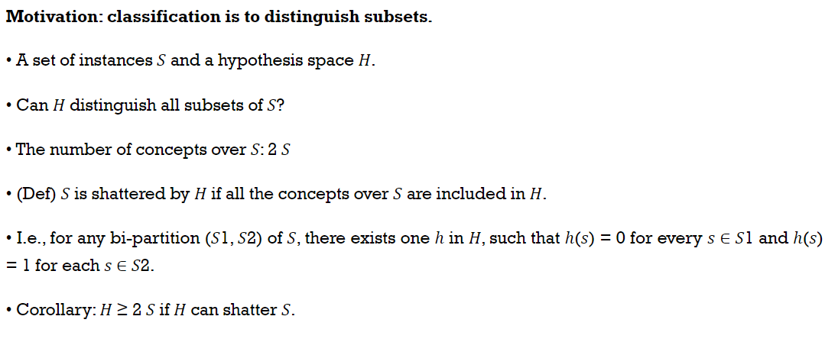
Sample Complexity for Infinite Hypothesis spaces

Slide 6
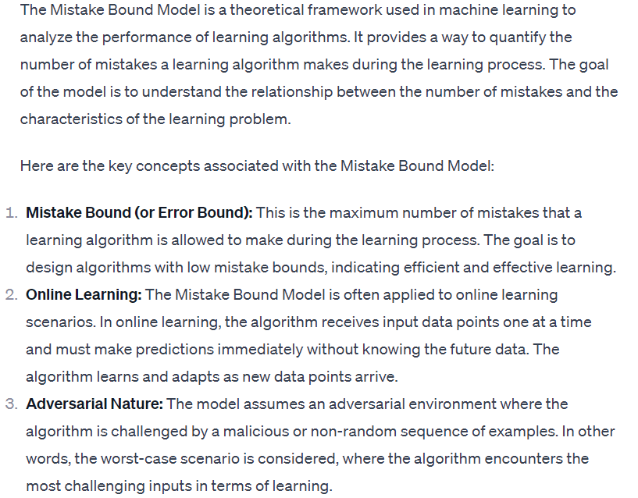
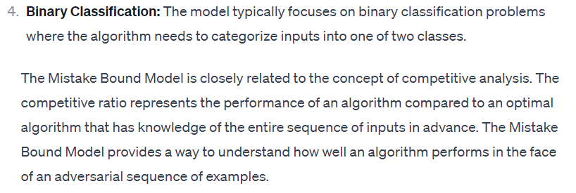
The Mistake Bound Model of Learning

Slide 7
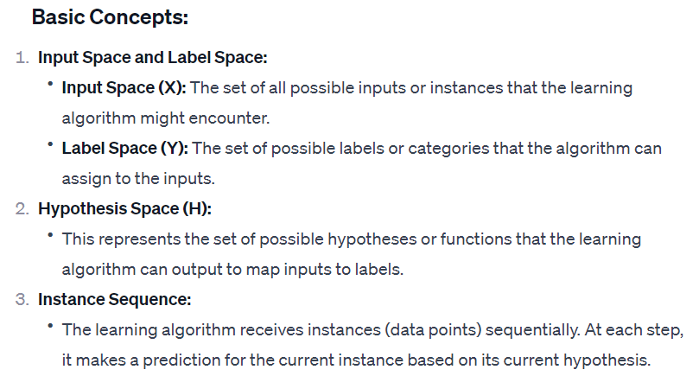

Slide 8
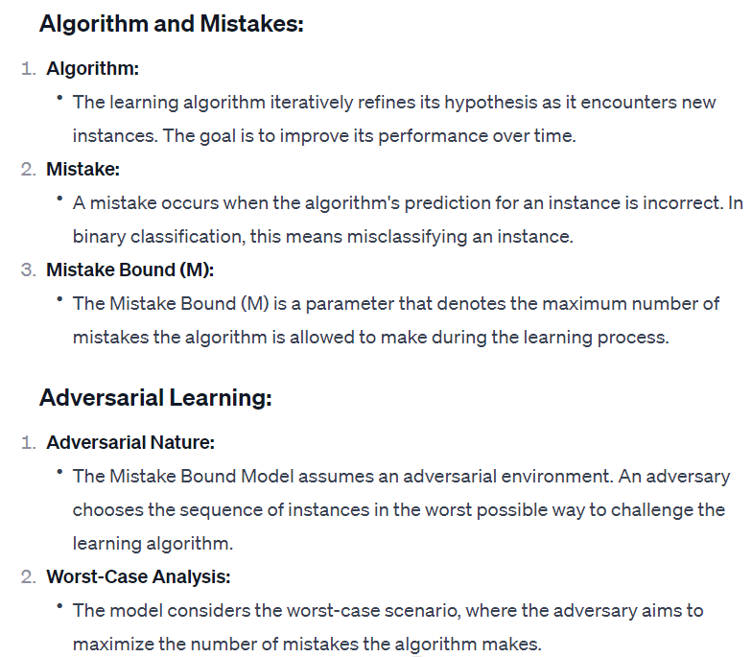

Slide 9
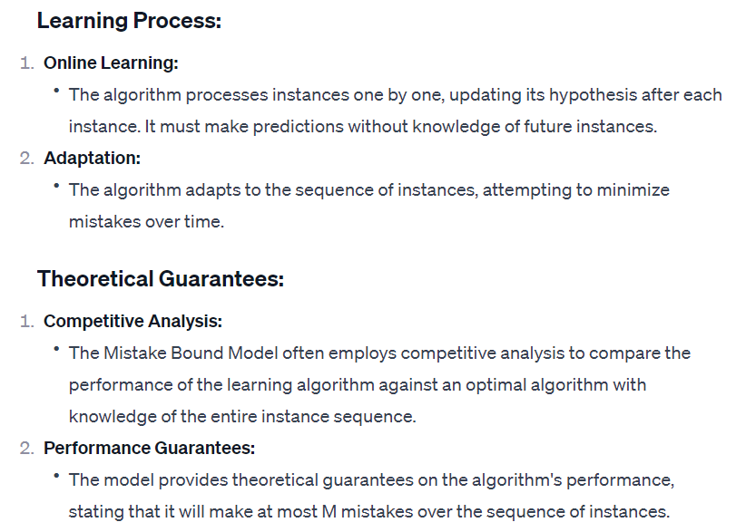

Slide 10
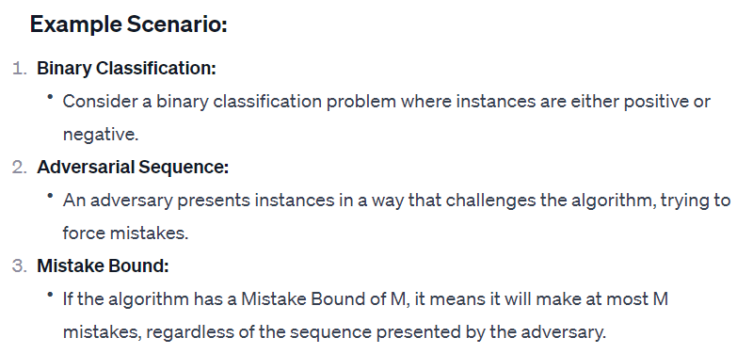

Slide 11
Instance-based learning
The Machine Learning systems which are categorized as instance-based learning are the systems that learn the training examples by heart and then generalizes to new instances based on some similarity measure. It is called instance-based because it builds the hypotheses from the training instances.
It is also known as memory-based learning or lazy-learning (because they delay processing until a new instance must be classified).
The time complexity of this algorithm depends upon the size of training data. Each time whenever a new query is encountered, its previously stores data is examined. And assign to a target function value for the new instance.

Slide 12
For example, If we were to create a spam filter with an instance-based learning algorithm, instead of just flagging emails that are already marked as spam emails, our spam filter would be programmed to also flag emails that are very similar to them. This requires a measure of resemblance between two emails. A similarity measure between two emails could be the same sender or the repetitive use of the same keywords or something else.
Advantages:
Instead of estimating for the entire instance set, local approximations can be made to the target function.
This algorithm can adapt to new data easily.

Slide 13
Disadvantages:
Classification costs are high
Large amount of memory required to store the data, and each query involves starting the identification of a local model from scratch.
Some of the instance-based learning algorithms are :
K Nearest Neighbor (KNN)
Self-Organizing Map (SOM)
Learning Vector Quantization (LVQ)
Locally Weighted Learning (LWL)
Case-Based Reasoning

Slide 14
K-Nearest Neighbor(KNN) Algorithm
KNN algorithms based on Supervised Learning technique.
KNN algorithm assumes the similarity between the new case/data and available cases and put the new case into the category that is most similar to the available categories.
KNN algorithm stores all the available data and classifies a new data point based on the similarity. This means when new data appears then it can be easily classified into a well suite category by using K- NN algorithm.
KNN algorithm can be used for Regression as well as for Classification but mostly it is used for the Classification problems.
KNN is a non-parametric algorithm, which means it does not make any assumption on underlying data.
It is also called a lazy learner algorithm because it does not learn from the training set immediately instead it stores the dataset and at the time of classification, it performs an action on the dataset.
KNN algorithm at the training phase just stores the dataset and when it gets new data, then it classifies that data into a category that is much similar to the new data.

Slide 15
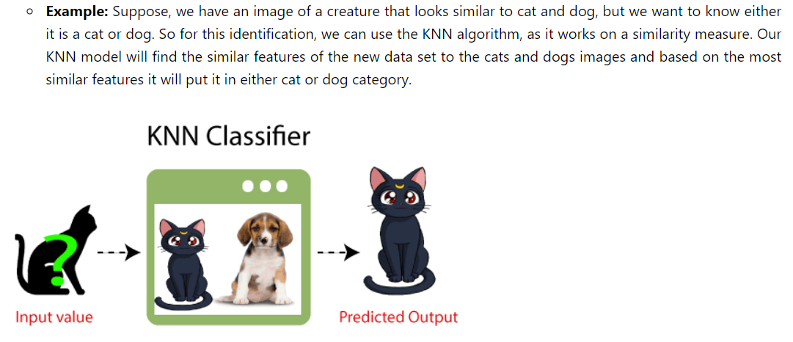

Slide 16
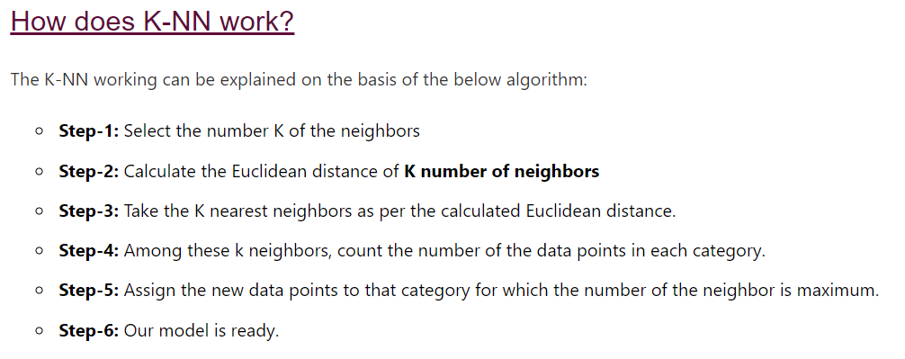

Slide 17
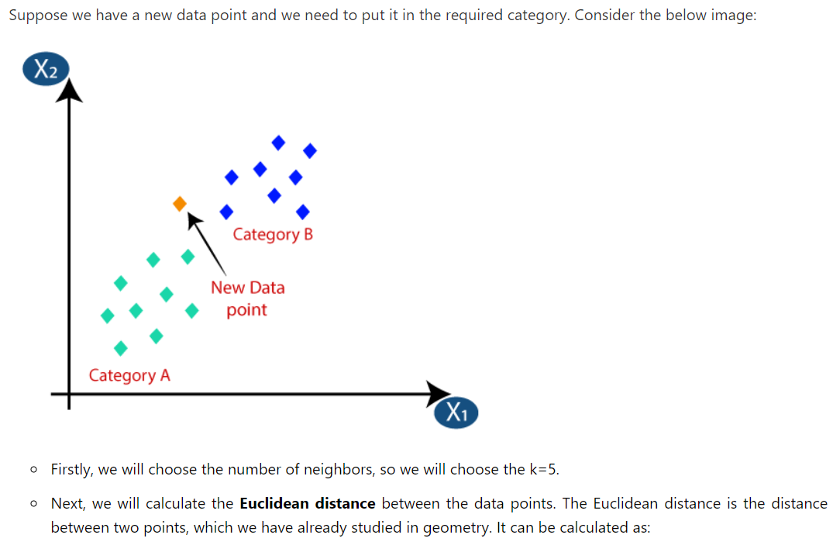
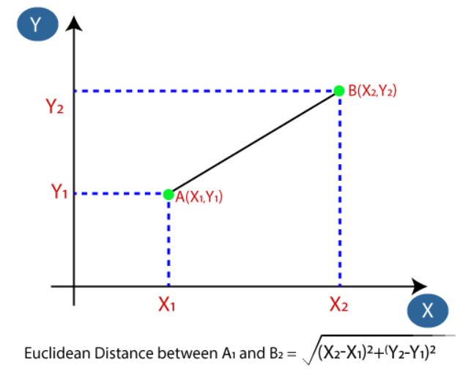

Slide 18
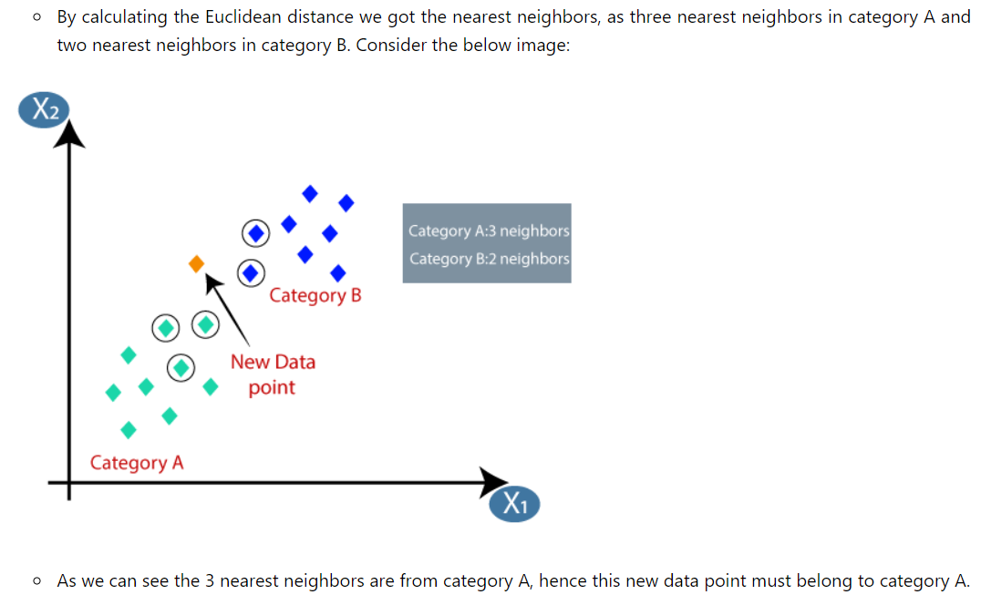

Slide 19
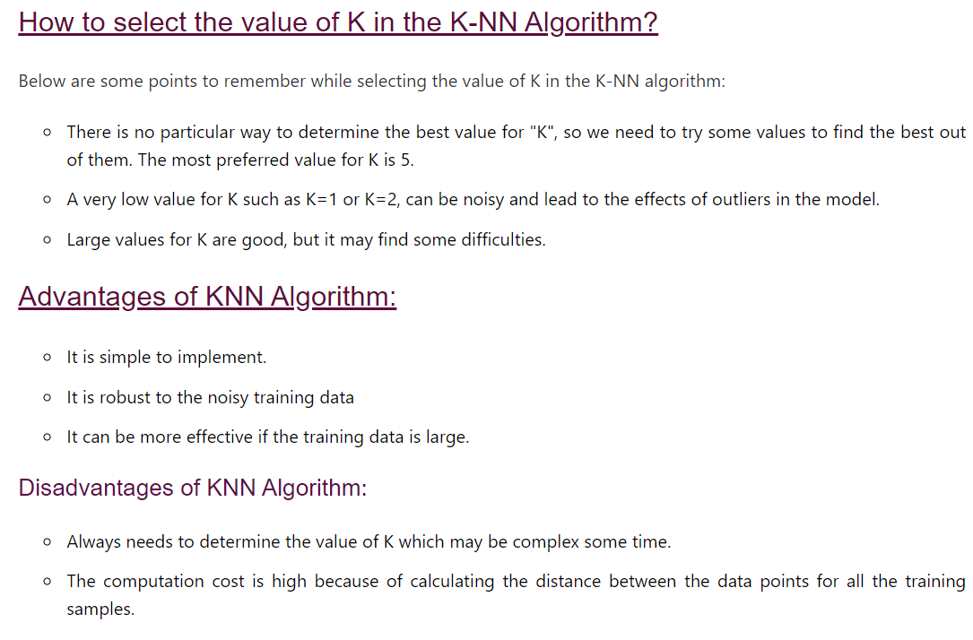

Slide 20
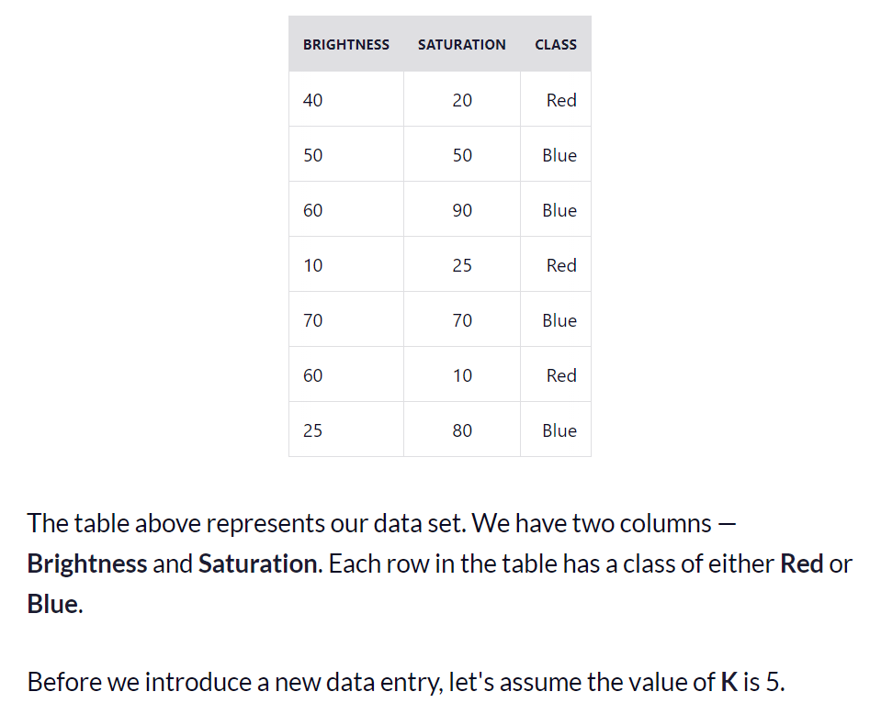
Example:

Slide 21
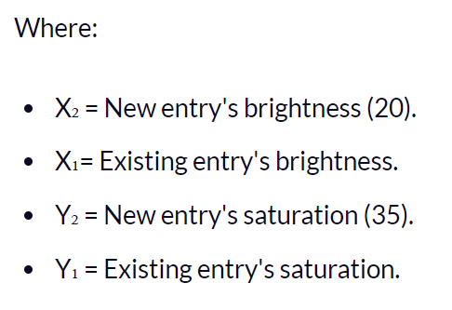
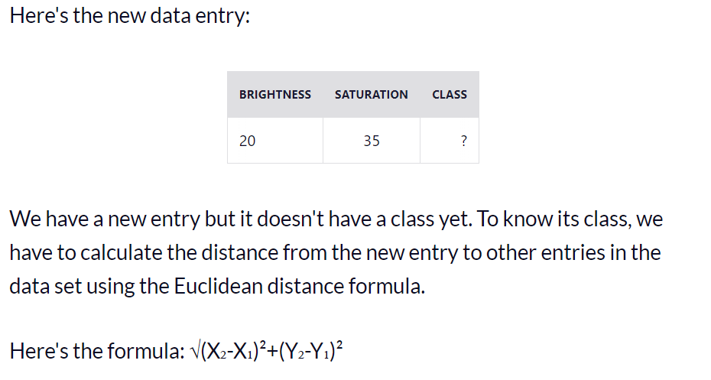

Slide 22
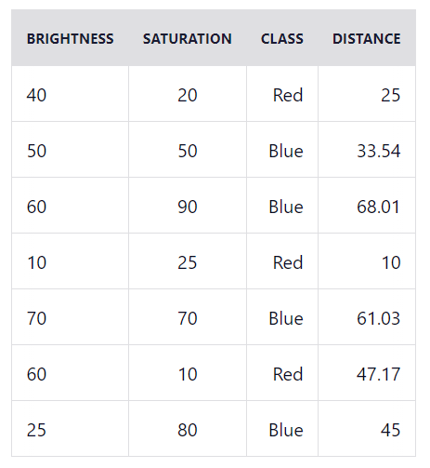
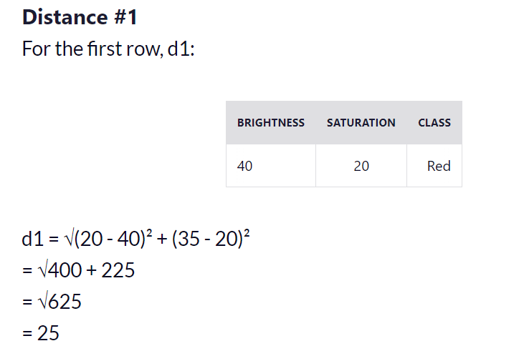

Slide 23
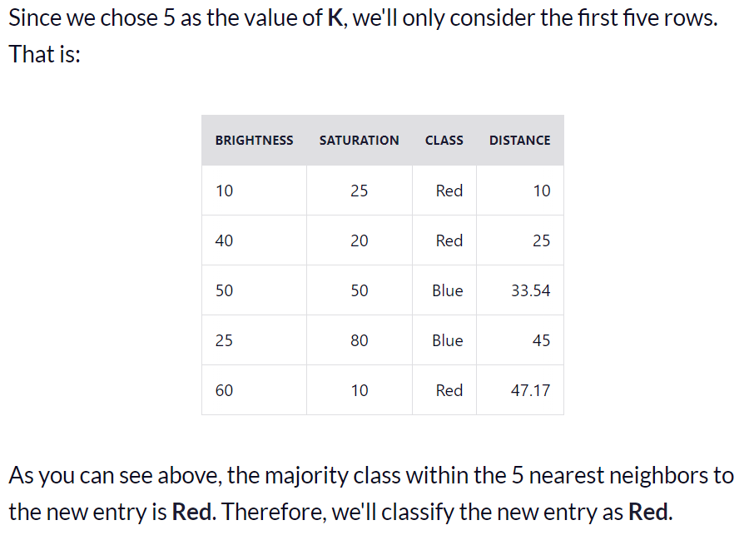

Slide 24
Regression
Regression is defined as a statistical method that helps us to analyze and understand the relationship between two or more variables of interest.
The process that is adapted to perform regression analysis helps to understand which factors are important, which factors can be ignored, and how they are influencing each other.
For the regression analysis is be a successful method two variables used:
1. Dependent Variable: This is the variable that we are trying to understand or forecast.
2. Independent Variable: These are factors that influence the analysis or target variable and provide us with information regarding the relationship of the variables with the target variable.

Slide 25
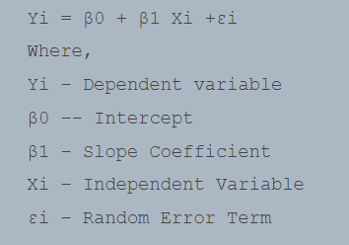
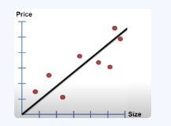
Linear Regression
The simplest of all regression types is Linear Regression which tries to establish relationships between Independent and Dependent variables.
Linear Regression is a predictive model used for finding the linear relationship between a dependent variable and one or more independent variables.
This regression works well when we are having linearly separable data.

Slide 26
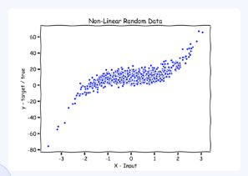
Locally Weighted Linear Regression (LWLR)
It is a non-parametric algorithm, unlike a typical linear regression algorithm which is a parametric algorithm. A parametric algorithm is an algorithm that doesn’t need to retain the training data when we need to make predictions.
This regression works well when we are having non linearly separable data.

Slide 27
Important Points:
LWLR is a non-parametric regression technique that fits a linear regression model to a dataset by giving more weight to nearby data points.
LWLR fits a separate linear regression model for each query point based on the weights assigned to the training data points.
The weights assigned to each training data point are inversely proportional to their distance from the query point.
Training data points that are closer to the query point will have a higher weight and contribute more to the linear regression model.
LWLR is useful when a global linear model does not well-capture the relationship between the input and output variables. The goal is to capture local patterns in the data.

Slide 28
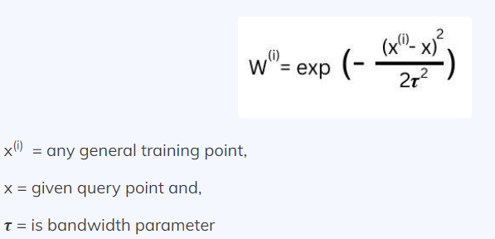
Assigning weights to a line- known as Kernel smoothing
A weight function which is given as:
The bandwidth parameter controls how quickly the weight should fall with the distance of the point with the training point. In simpler terms, it controls the width of how varied the data is.

Slide 29
Advantages of Locally Weighted Linear Regression
It is a simple algorithm.
It can give excellent results when we have non-linear data points, and features are less.
Disadvantages:
Need to evaluate whole dataset every time a new data comes.
Computation cost is high.
Memory requirement is more.

Slide 30
Radial Basis Function
Radial Basis Kernel is a kernel function that is used in machine learning to find a non-linear classifier or regression line.
Kernel Function:
Kernel Function is used to transform n-dimensional input to m-dimensional input, where m is much higher than n then find the dot product in higher dimensional efficiently.
The main idea to use kernel is: A linear classifier or regression curve in higher dimensions becomes a Non-linear classifier or regression curve in lower dimensions.

Slide 31
Case Based Reasoning (CBR) Classifier
Case-Based Reasoning classifiers (CBR) use a database of problem solutions to solve new problems. It stores the tuples or cases for problem-solving as complex symbolic descriptions.
When a new case arises to classify, a Case-based Reasoner(CBR) will first check if an identical training case exists. If one is found, then the accompanying solution to that case is returned.
If no identical case is found, then the CBR will search for training cases having components that are similar to those of the new case. Conceptually, these training cases may be considered as neighbors of the new case. The CBR tries to combine the solutions of the neighboring training cases to propose a solution for the new case.

Slide 32
Applications of CBR includes:
Problem resolution for customer service help desks, where cases describe product-related diagnostic problems.
It is also applied to areas such as engineering and law, where cases are either technical designs or legal rulings, respectively.
Medical educations, where patient case histories and treatments are used to help diagnose and treat new patients.
Challenges with CBR
Finding a good similarity metric (eg for matching subgraphs) and suitable methods for combining solutions.
Selecting salient features for indexing training cases and the development of efficient indexing techniques.

